Slide 1

SQL Murder Mystery
By – Md Javed Momin

Slide 2
The Setup
A crime has taken place and the detective needs your help. The detective gave you the crime scene report, but you somehow lost it. You vaguely remember that the crime was a murder that occurred sometime on Jan.15, 2018 and that it took place in SQL City .

Slide 3
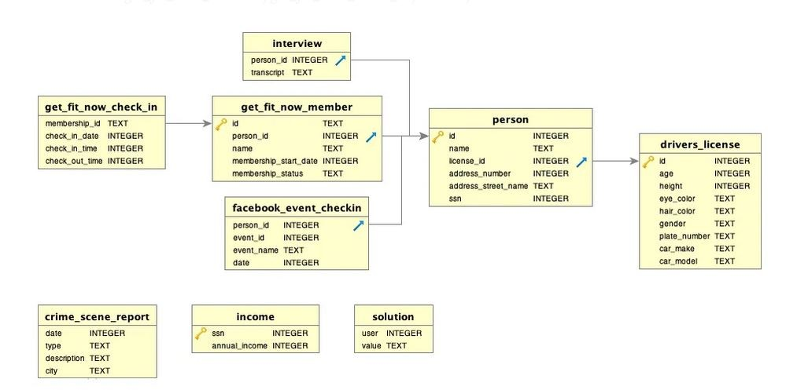
Star Schema

Slide 4
The Investigation
To accomplish this challenge I am interested in the description of the crime. So let's start!

Slide 5
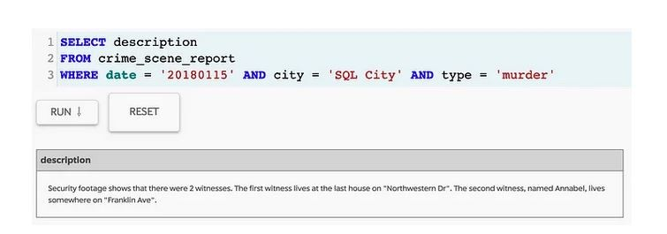

Slide 6
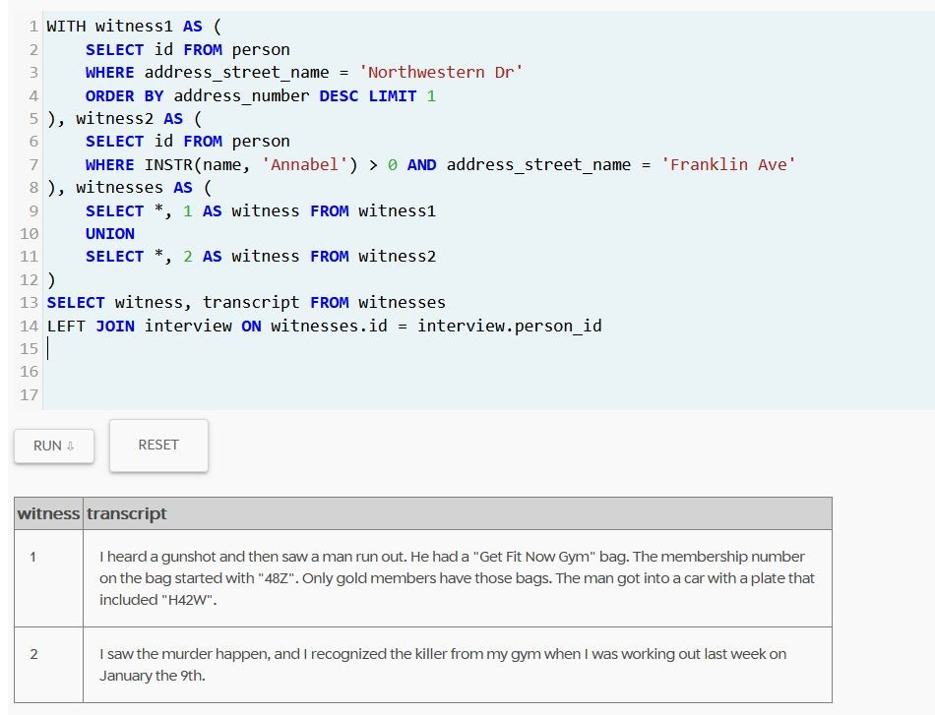

Slide 7
Investigation
That's some good information! So Annabel saw the murder happend on the 9th of January 2018 and the killer is a gym member. Now I can zoom in on the gym membership id '48Z%'.

Slide 8
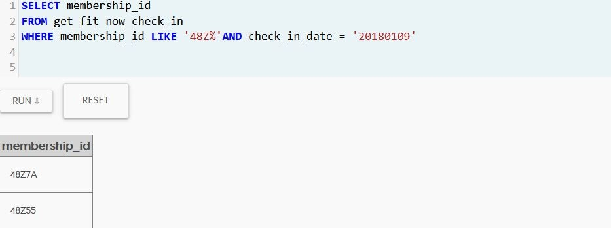

Slide 9
Investigation
Two member_ids with "48Z" were checked-in on the 9th of January 2018. So let's have a look at the members by using the get_fit_now_member table.

Slide 10
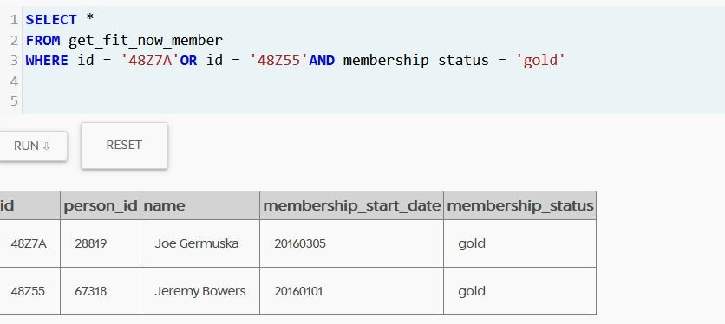

Slide 11
Investigation
So we have two gold members coming forward as suspects. But who is the killer..... To find out, another check on the partial license plate "H42W" is needed!
I chose to combine the names from the person table with the license plate id numbers. The license id number can then be used as id in the drivers_license table to look up the license plate number.

Slide 12
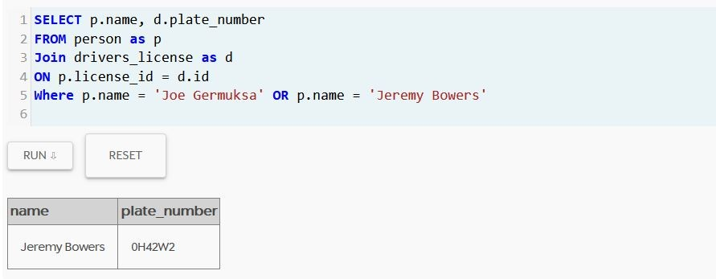

Slide 13
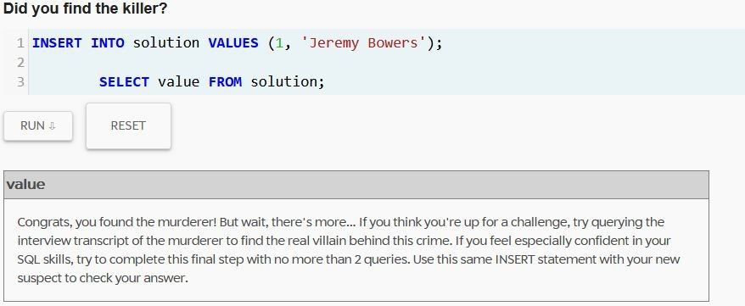

Slide 14
Interview
It looks like Jeremy Bowers took orders from someone else. Let's see what he has to say by pulling out the interview transcripts based on Jeremy Bowers person number: 67318.

Slide 15
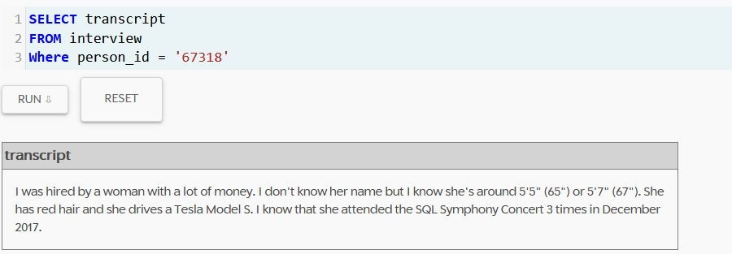

Slide 16
Investigation
That's a lot of information with this it should be possible to identify a suspect! So the suspect is a woman, between 65" and 67", with red hair and drives a Tesla Model S. And the attend the SQL Symphony Concert 3 times in December 2017. Let's give it a try to find this woman!

Slide 17
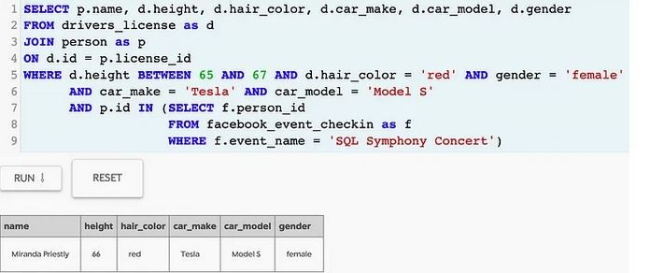

Slide 18
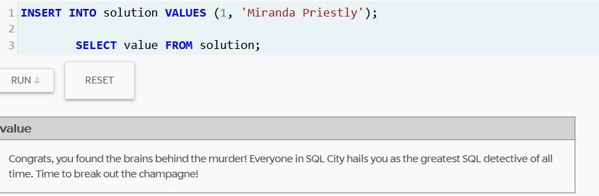

Slide 19
Conclusion
The murder was Jeremy Bowers!
The master brain behind the murder was Miranda Priestley!

Slide 20
Thank You!!!

